Slide 1
Anomaly Detection in Credit Card Transactions Presentation
Presented by Hemanga Mazumdar

Slide 2
INDEX
1 Introduction
2 Overview of project
3 Consolidated Dashboard
4 Key Findings
5 Charts and Graphs
6 Recommendations

Slide 3
Introduction
The aim of this presentation is to provide an understanding of the insights related to credit card transactions in real life. The goal is to provide you with a comprehensive overview of day to day credit card transactions and recommend or suggest methods to keep fraudulent credit card transactions in check.

Slide 4
PROJECT OVERVIEW
Total number of credit card transactions done monthly and yearly
The total amount of credit card transactions, both normal and fraud
Compare fraud credit card transactions with normal credit card transactions

Slide 5
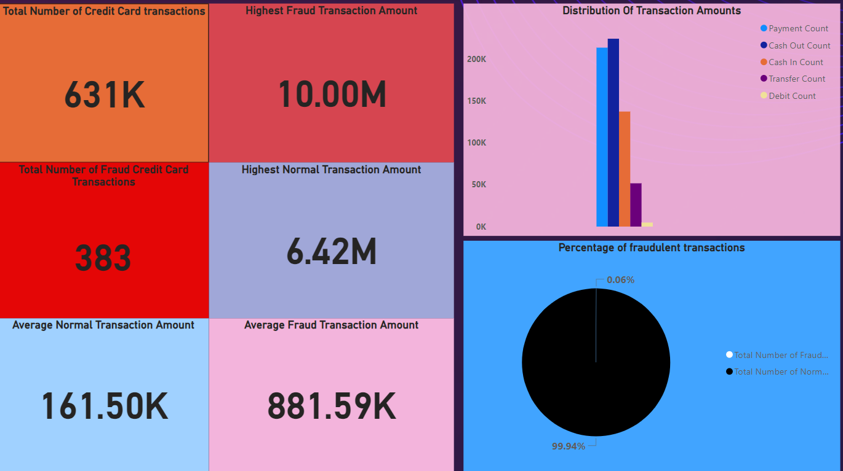
A BROADER LOOK…..

Slide 6
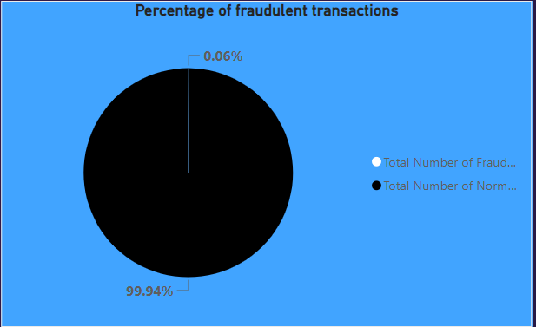

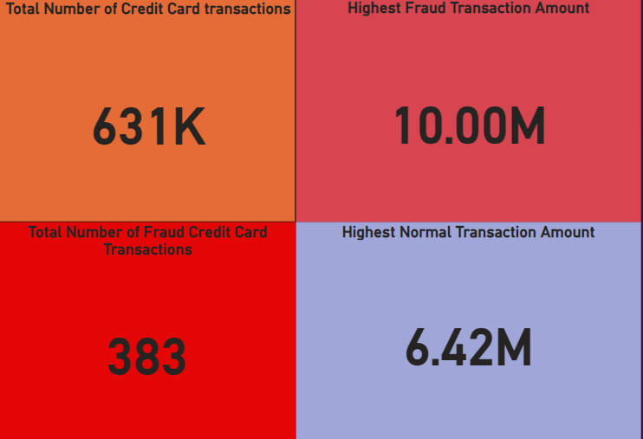
KEY FINDINGS
The percentage of fraud credit card transactions was a mere 0.6%, compared to the percentage of normal credit card transactions, which is 99.94%.
The total number of credit card transactions was 631 lakh, out of which 383 were fraud. The highest normal transaction amount stands at 6.42M, while the highest fraudulent transaction amount stands at 10M.

Slide 7
RECOMMENDATIONS
A METHOD LIKE ONE TIME PASSWORD TO COMPLETE TRANSACTIONS AMOUNTING OVER 6M.
FREQUENT MONITORING OF TRANSACTIONS DONE AFTER HOUR 32, AS IT CAN BE SEEN THAT TRANSACTIONS INCREASE AFTER THIS HOUR.

